Slide 1
Healthcare Assistant | G.Yogeshwar & M Sneha
Review - II

Slide 2
Team Members
G.Yogeshwar | 19MIS1151
Sneha. M |19MIS1103

Slide 3
Resolved Issues
Promoting the use of material Design
The software has been designed according to the material Design.It is a design language that Google developed in 2014
That promoted the use of card motifs and grid based layouts to enhance the user interface and user experience of the application. This helps in enhancing the fluidity of the application and further enhanced the mobility of the application
Enhancing the personalisation of the application
Most of the application was very technical. Our application has more defined sentences and use of various colours like Red, Green and Blue to indicate the status of the current standings.
The main theme of the application is sky blue, since that is the most pleasing colour
Inclusion of addition features & Maintaining accuracy
Many application were specific about uni-functionality. Our application focuses on the mental well-being and in improving their mental health. We have created a methodology called ‘ Sub - questioning’ system to ensure that the user has fed correct input to obtain perfect and accurate results.
👨🏼‍⚕️

Slide 4
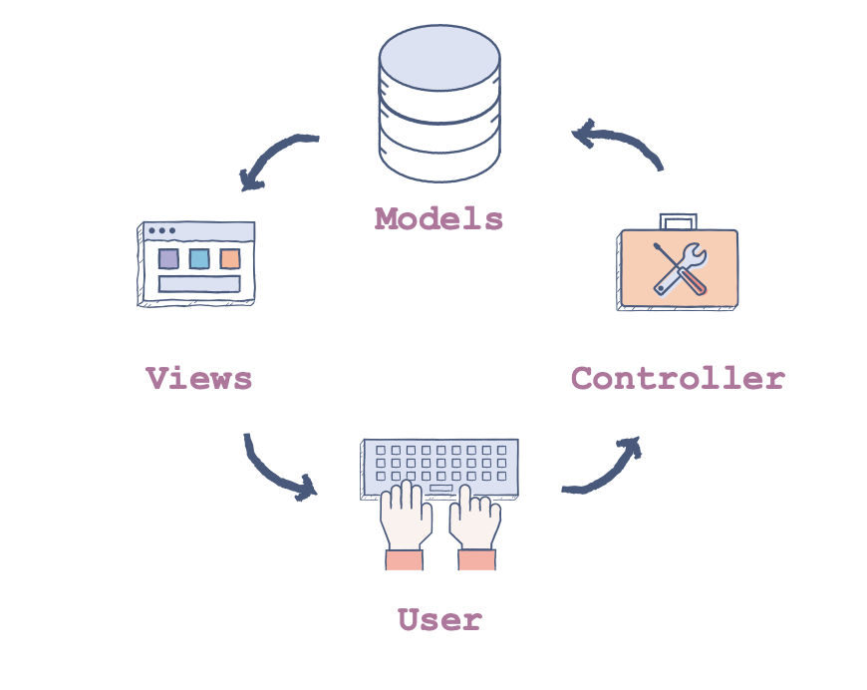
System Architecture
MVC Architecture
MVC architecture is used in the designed application.
It is a software architectural pattern in which the application logic is divided into three components on the basis of functionality. These components are called:
Models - represent how data is stored in the database, such as login table, customer reports table and the index table.
Views - the components that are visible to the user, such as an output or a GUI Controllers. The login page, Registration page and the application pages that are designed using swing
Controller - the components that act as an interface between models and views
👨🏼‍⚕️

Slide 5
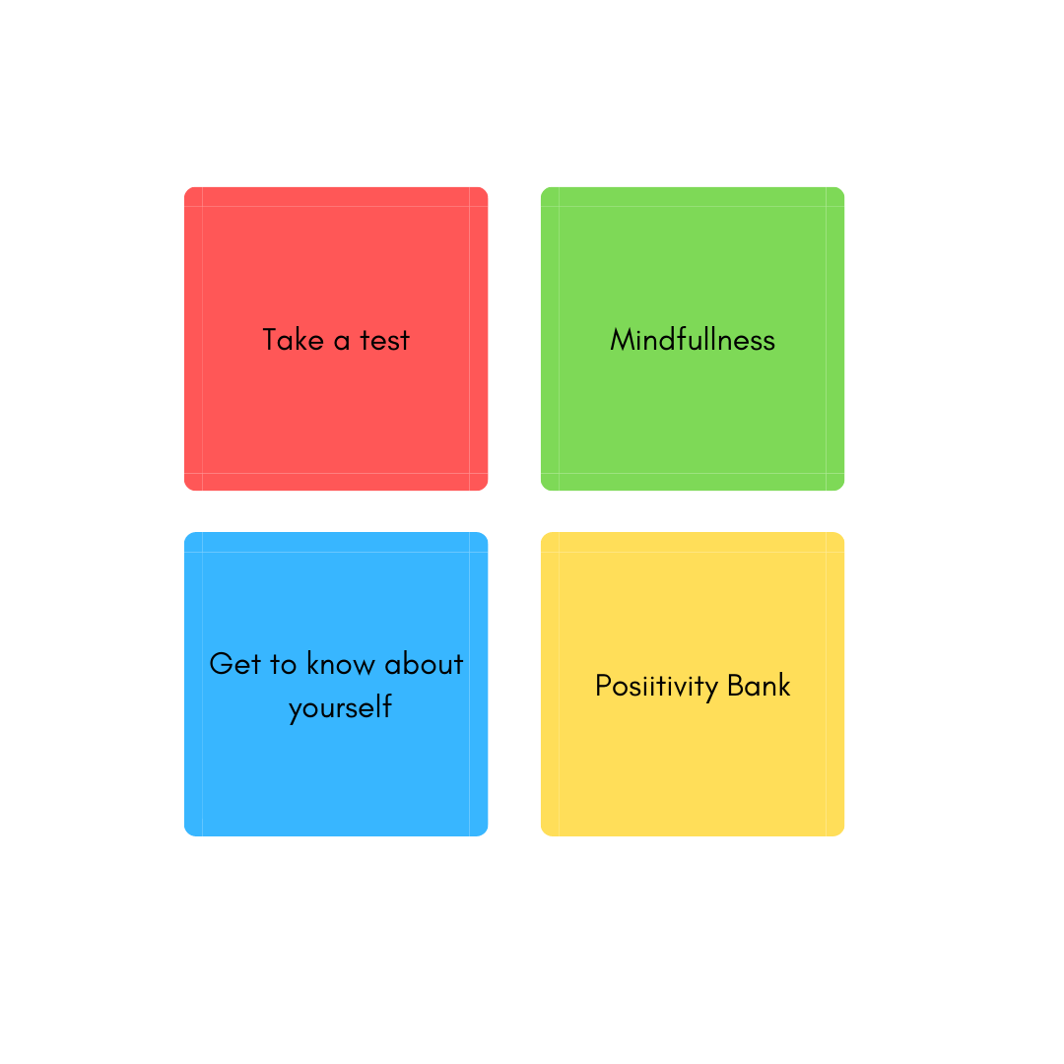
List of modules
Login & Registration
Take a Test
Mindfullness
Positivity Bank
Get to know you
👨🏼‍⚕️

Slide 6
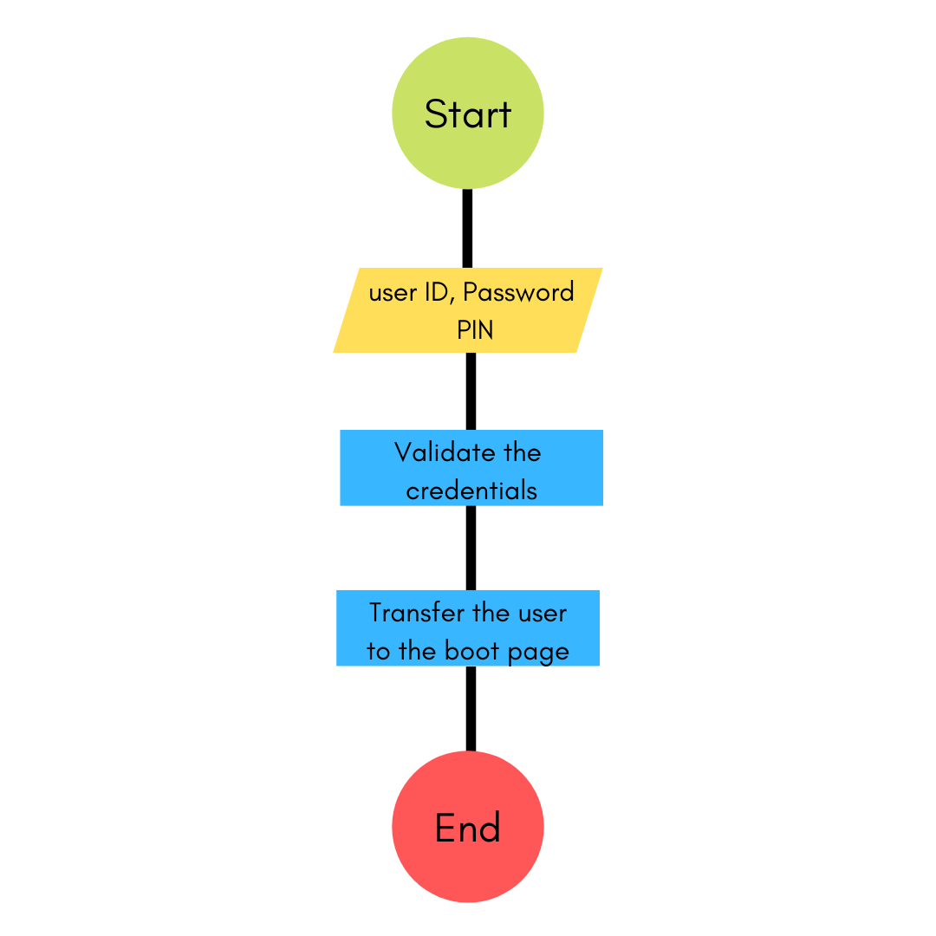
Login & Registration Module
Login
The login page is the boot page of the application. The user has to enter the credentials such as login ID (email-ID) and his password to enter into the application. Upon successful entry, The user is navigated to the secondary boot page which contains the path way to all the major functionalities of the app.
The login page also serves as the bridge to create a new user account. A link has been provided at the bottom of the login page to navigate to the registration portal.
Registration
In the registration module, The user provides his user ID password and email ID. The user has to set a PIN to view his personal records in the later stage of the application
👨🏼‍⚕️

Slide 7
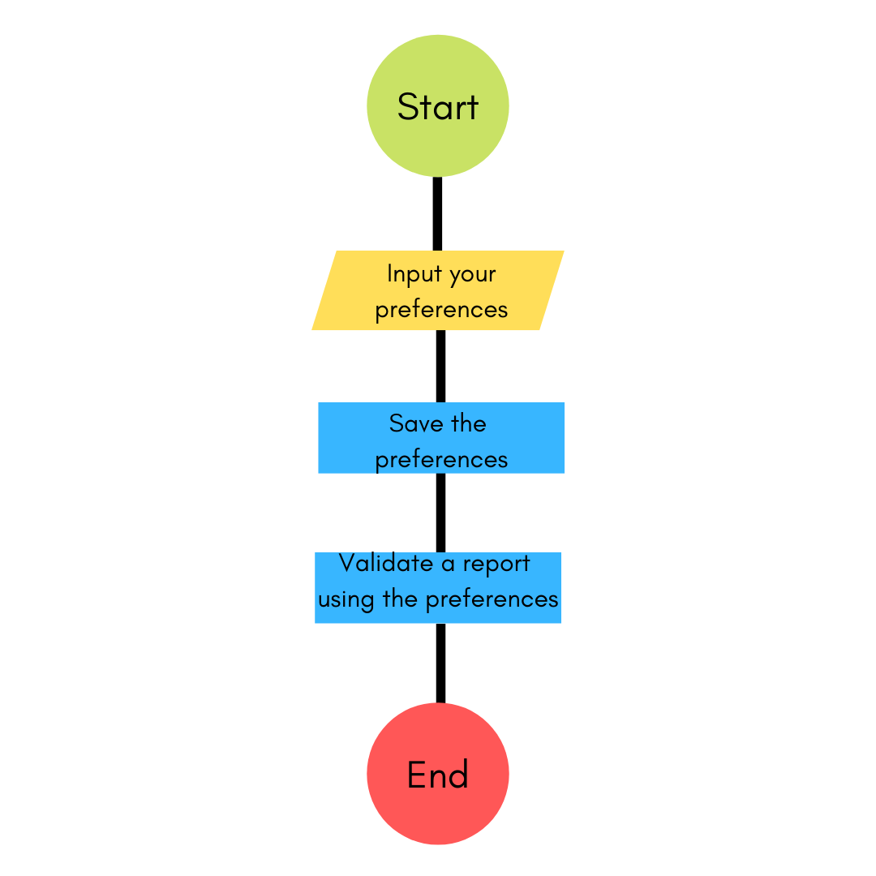
Take a Test
Once the test has started, the person’s weight and height is taken as an input from the user to calculate further results. Based on the BMI, further questions are viewed to the user. Every set of questions has a common topic, which helps the user to attend the test in a fluid manner. A question is followed by a sub question to take even more control over the firmness and accuracy of the result.
👨🏼‍⚕️

Slide 8
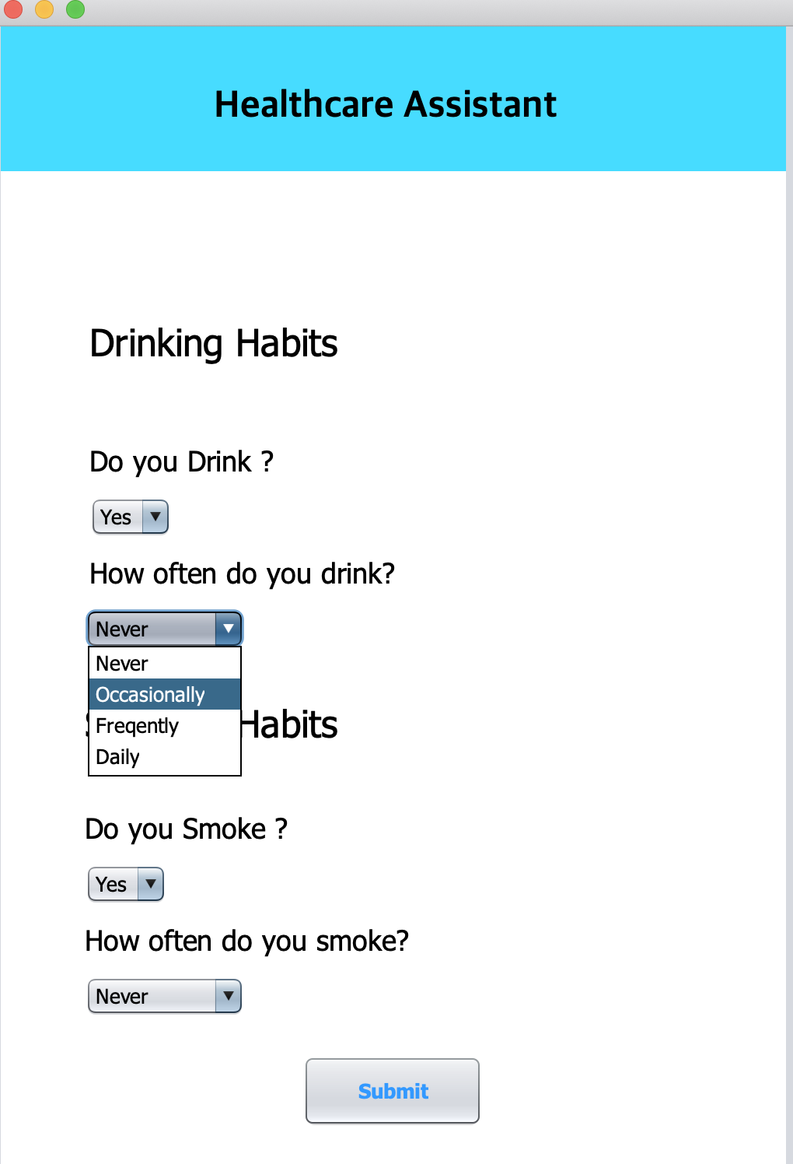
Take a Test
The application has a series of questions which falls under addictive habits. Under Addictive habits, Drinking and smoking habits are in the series of questions. Every question is followed by a sub-question.
For instance The user has enable that he is under addictive habits, further he is asked if he has drinking / smoking habits. Further, he is asked if he smokes / drink occasionally or frequently or daily to ensure better accuracy of results.
👨🏼‍⚕️

Slide 9
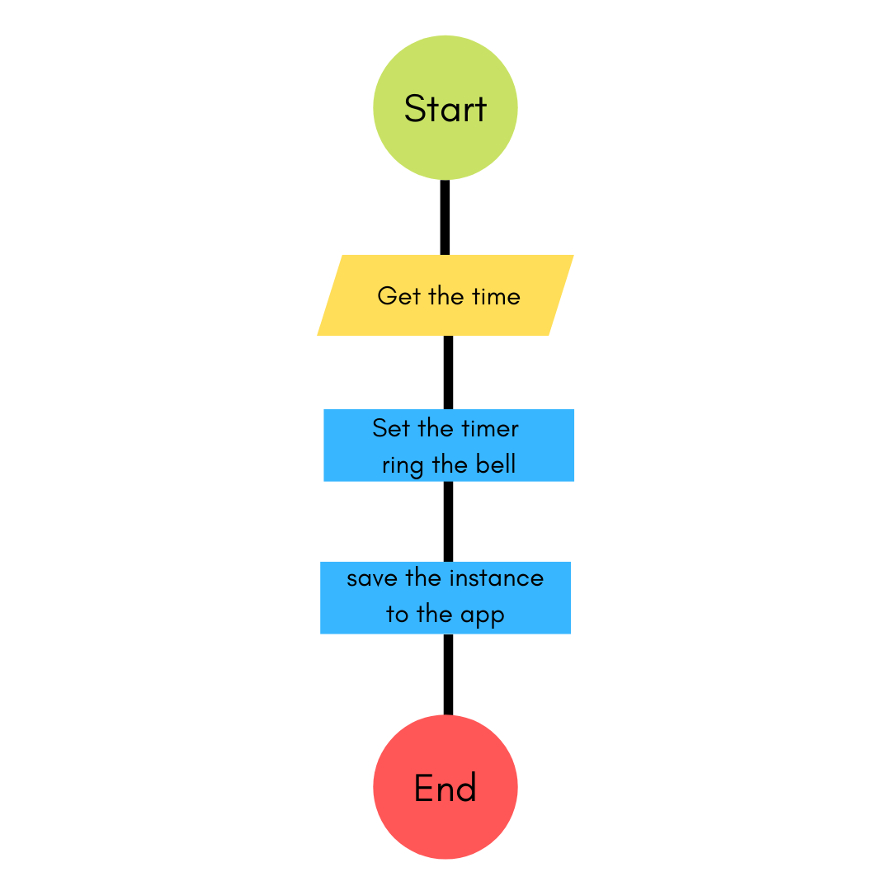
Mindfullness
In today’s fast-pacing world, Everyone is stressed and every one needs mindful time at least once or twice a day. This feature has been included in the healthcare assistant application to ensure the user’s mental well-being.
The user can set a timer of a particular time. The timer is set and a bell is knocked at the start of the meditation. Further, once the stipulated time comes to a halt, the user is further alerted by another bell. The instance of meditation gets saved in the application.
👨🏼‍⚕️

Slide 10
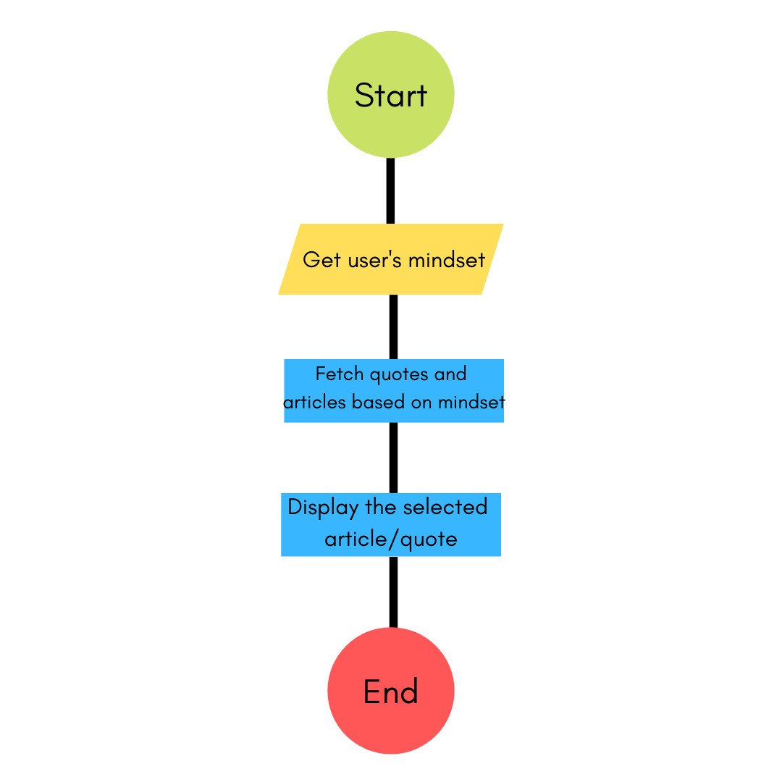
Positivity Bank
Everyone has a motivating factor that pushes people’s life. We have included a functionality named positivity bank, which helps in improving the will power and the positivity of the user.
The current / existing feeling of the user is gained via a pop-up. Based on the user’s input, The user is asked to write a short paragraph, saved as a journal. Appropriate articles and wordings are received from the application to create a positive vibe.
Every time when the user enters the bootpage, A random article is displayed to motivate the mental wellbeing of the user.
👨🏼‍⚕️

Slide 11
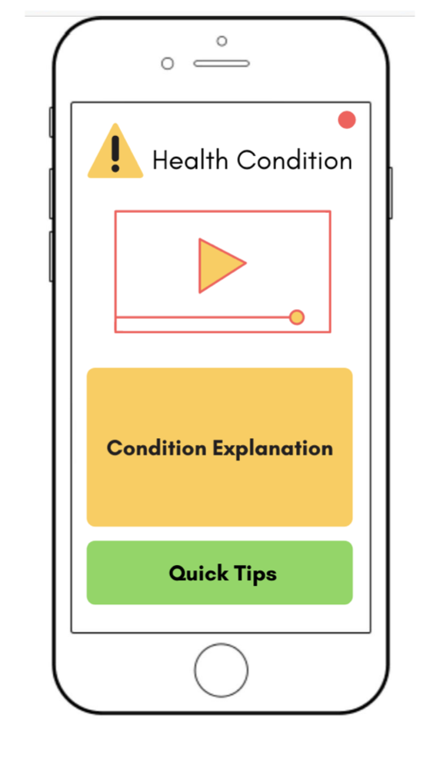
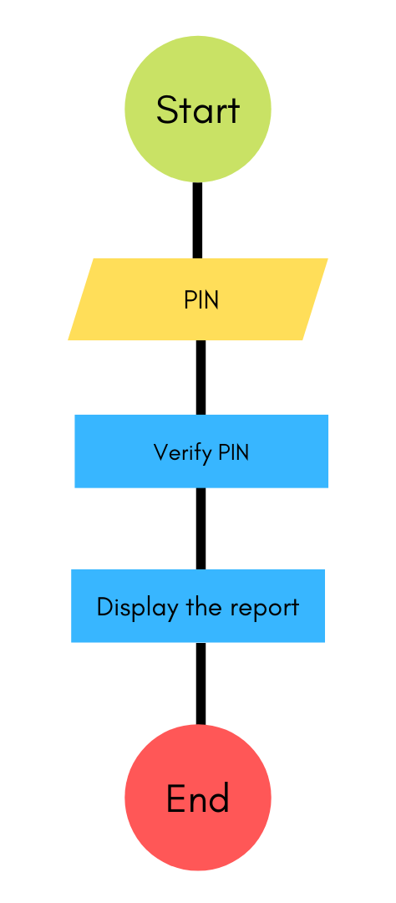
Get to Know yourself
Once the take a test is completed, the user is directed to the ‘ Get to know yourself ‘ module. This module has all the user reports based on their input and preferences. This module has the following divisions
Results
Suggestions
Severity
Precautions
Every sub-module is indicated via colours to denote the severity of the particular health condition. Green indicates normal, Orange with moderate and red to severe. These colours help in easy identification of the severity for the patient. This also helps in visual enhancement and the user experience of the application
👨🏼‍⚕️

Slide 12
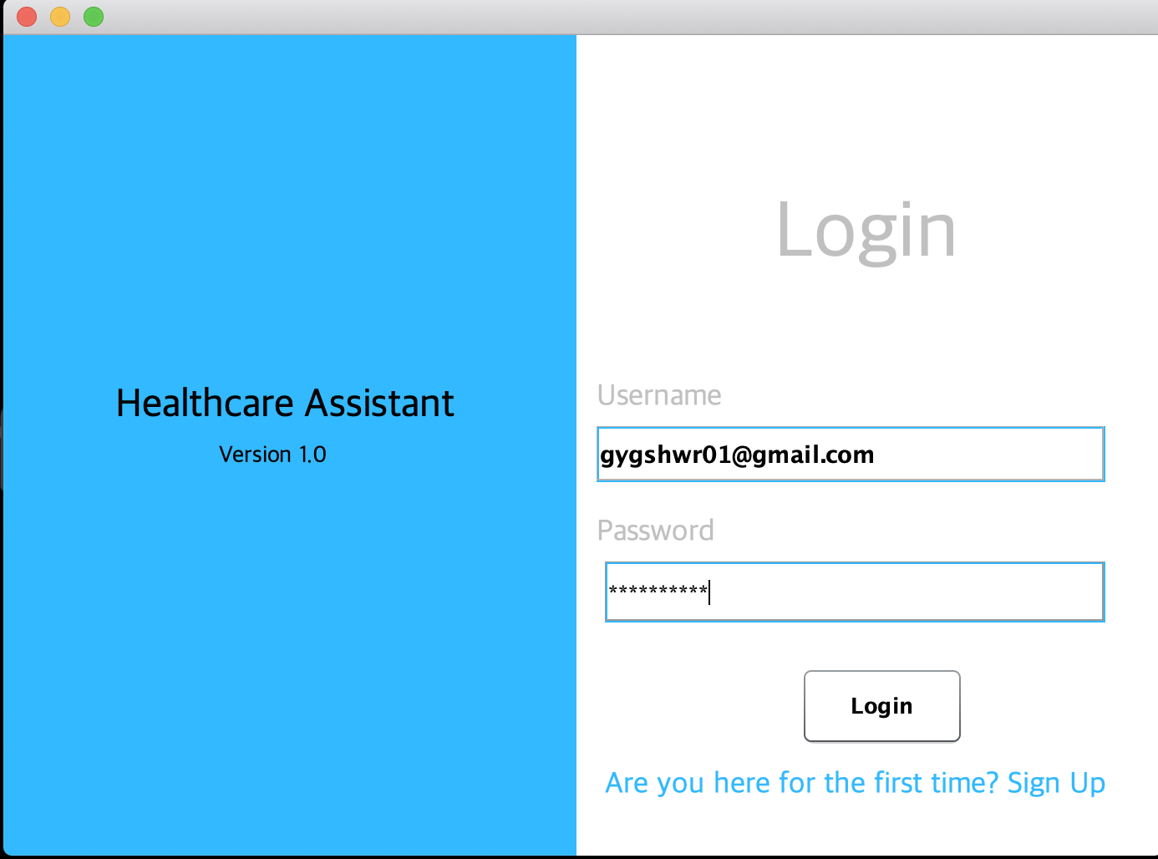
Screenshots of the application
👨🏼‍⚕️

Slide 13
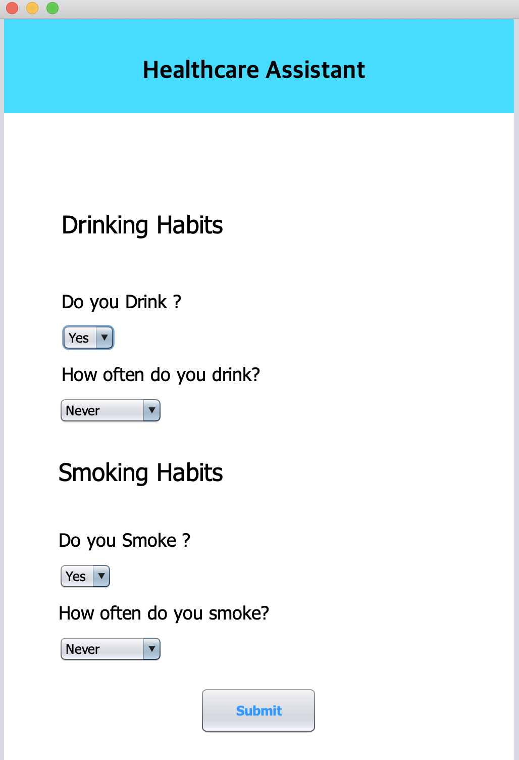
Screenshots of the application
👨🏼‍⚕️

Slide 14
Thank You

